Slide 1
Advanced Statistics for Researchers
Meta-analysis and Systematic Review
Avoiding bias in literature review and calculating effect sizes
Dr. Chris Rakes
October 9, 2013
With Special Thanks to Dr. Jeff Valentine

Slide 2
Research Statistics Framework
Conceptual Framework(s)
Research Design, Missing Data, Statistical Assumptions, Measurement Reliability & Validity
Meta-Analysis
Structural Equation Modeling
Hierarchical Linear Modeling
Item Response Theory
Bayesian Estimation
Secondary Data Analysis
Descriptive & Inferential Statistics
w/ Probability
General Linear Model
(M)AN(C)OVA
Simple and Multiple Regression
Exploratory Factor Analysis
Qualitative Data Analysis
Writing for Publication

Slide 3
In this Session
Using Systematic Review to Obtain a Better Literature Review/Conceptual Framework
Minimizing Publication Bias
How to compute various types of effect sizes
Fixed vs. Random Effects
Computing a Design Effect

Slide 4
Using Systematic Review to Obtain a Better Literature Review/Conceptual Framework

Slide 5
Why Systematic Review?
Synthesis of results of multiple studies provides more compelling evidence than results of any single study.
Less effected than single studies by sampling error
More confidence in results: place single studies in context

Slide 6
Problems with Narrative Reviews
Literature search virtually never thorough in scope or in reporting how literature was located.
Under-reported methodology (why were certain studies included or excluded?)
Often unstated, virtually always arbitrary
Potential Confirmation Bias
Conflate statistical significance with effect size
Ignore Type II error in primary studies
Ignore publication bias
Often employ vote counts

Slide 7
Steps for a Systematic Review
Goal: Uncover All Relevant Studies
More realistic goal: Minimize differences between retrieved and un-retrieved studies.
Population of Studies
All Relevant Studies
Accessible Population
All Retrievable Relevant Studies
Retrieved Studies
Sample

Slide 8
Searching Electronic Databases
Always consult with a professional librarian!!!!
Identify potentially relevant databases.
Search terms must appear in an indexed field.
Often must be exhaustive with terms
Deep substantive knowledge of the research questions is required to capture the relevant terms
Strongly susceptible to disciplinary bias (vet thoroughly)
Full text search capability will help some

Slide 9
Gray Literature
Generic search engines such as Google and Google Scholar can sometimes help identify unpublished material
ProQuest Dissertations and Theses will house dissertation research http://aok.lib.umbc.edu/databases/dblink.php?DBID=370
Research Organizations in Your Field often house technical reports on their websites (e.g., CRESST)
Bibliographies of already-identified relevant studies.

Slide 10
Publication Bias
Known difference in statistical significance of published vs. unpublished studies.
The best defense is a comprehensive, systematic search for literature.

Slide 11
Key Decisions in Literature Review
Inter-Rater Agreement on Key Decisions
Does the study look like it might be relevant?
If yes, retrieve full text of article.
Is the study eligible for inclusion?
Base final decision on full text.
Double code as much as possible.

Slide 12
Browse UMBC’s Databases

Slide 13
Computing Effect Sizes

Slide 14
Statistical Significance
Interpretation of a p-value
Given a true null hypothesis, the probability of observing a relationship at least as large as the one being tested.
The confidence we can state the direction of a relationship (positive or negative)
Likelihood that a result is due to random chance (i.e., sampling error).
A p-value is a function of sample size and effect size.

Slide 15
Effect Size
Estimates the magnitude (size) of a relationship (i.e., how much impact?)
Three families of effect size
Correlation Coefficients (r)
Odds Ratios (OR; Two Dichotomous Variables)
Mean Differences (d)

Slide 16
The role of sample size
Any non-zero difference in means will be statistically significant given a large enough sample. Assume:
M_{T} = 100.1, M_{C} = 100.0, s_{p} = 15
n per group | d | t-test p-value
100 | 0.01 | 0.962
1000 | 0.01 | 0.882
10000 | 0.01 | 0.637
100000 | 0.01 | 0.136
200000 | 0.01 | 0.035

Slide 17
Two categories of Effect Sizes
Unstandardized
Effects expressed directly in terms of the measured outcome (e.g., “3 points on an IQ scale”)
Most useful when scale is well understood and relevant studies all use the same scale.
Standardized: transforming effects to have similar meaning across scales
Standard Deviation Units
Percent Change
Proportion of Variance Explained

Slide 18
Computing an Odds Ratio
 | Graduated | Didn’t Graduate
Treatment | 2 (a) | 6 (b)
Control | 9 (c) | 12 (d)
$OR=\frac{ad}{bc}=\frac{2∗12}{9∗6}=0.44$
${SE}_{OR}=\sqrt{\frac{1}{a}+\frac{1}{b}+\frac{1}{c}+\frac{1}{d}}=\sqrt{\frac{1}{2}+\frac{1}{6}+\frac{1}{9}+\frac{1}{12}}=0.928$
$95\%CI=0.44±1.96∗.928=−1.38, 1.82$

Slide 19
Standardized Effect Size: Mean Difference (d or Cohen’s d)
${ES}_{SM}=d=\frac{{\overline{Y}}_{1}−{\overline{Y}}_{2}}{s_{p}}$,
where $s_{p}$is the pooled standard deviation.
${SE}_{d}=\sqrt{\frac{n_{1}+n_{2}}{n_{1}n_{2}}+\frac{d^{2}}{2\left(n_{1}+n_{2}\right)}}$
$s_{p}=\sqrt{\frac{{\left({SD}_{1}\right)}^{2}+{\left({SD}_{2}\right)}^{2}}{2}}$
Study | n₁ | Ȳ₁ | s₁ | (s₁)² | n₂ | Ȳ₂ | s₂ | (s₂)²
1 | 59 | 17.25 | 3.26 | 10.6276 | 50 | 19.32 | 3.53 | 12.4609

Slide 20
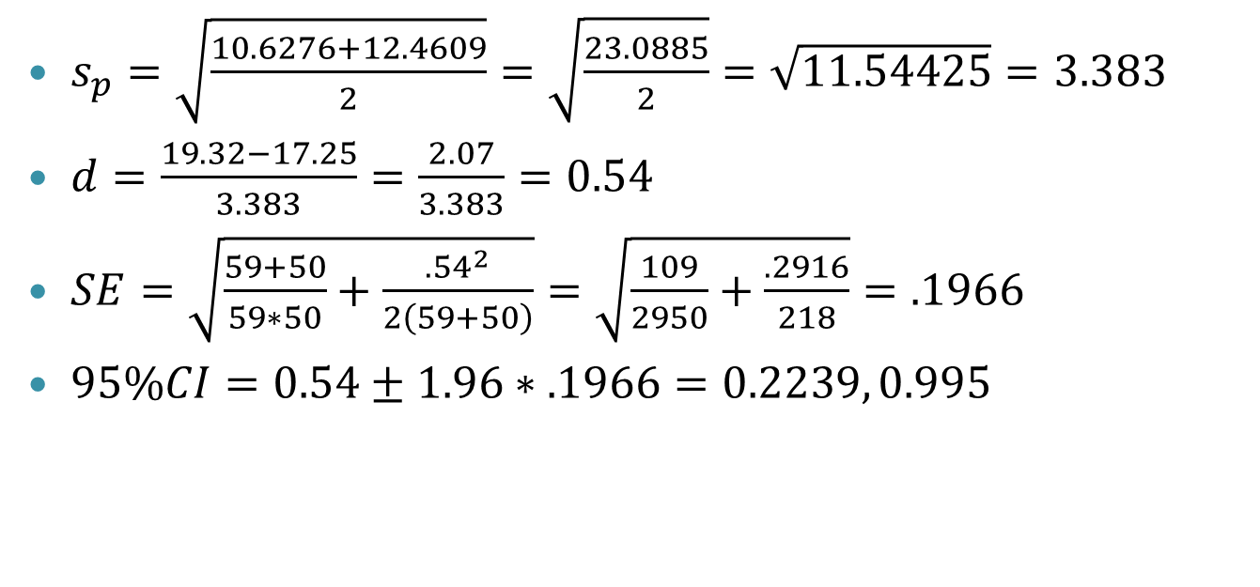
Computing ES: An Example
Study | n₁ | Ȳ₁ | s₁ | (s₁)² | n₂ | Ȳ₂ | s₂ | (s₂)²
1 | 59 | 17.25 | 3.26 | 10.6276 | 50 | 19.32 | 3.53 | 12.4609
$s_{p}=\sqrt{\frac{10.6276+12.4609}{2}}=\sqrt{\frac{23.0885}{2}}=\sqrt{11.54425}=3.383$
$d=\frac{19.32−17.25}{3.383}=\frac{2.07}{3.383}=0.54$
$SE=\sqrt{\frac{59+50}{59∗50}+\frac{{.54}^{2}}{2\left(59+50\right)}}=\sqrt{\frac{109}{2950}+\frac{.2916}{218}}=.1966$
$95\%CI=0.54±1.96∗.1966=0.2239, 0.995$

Slide 21
Weighting Effect Sizes
Weight by the inverse of the variance of the effect size
$\frac{1}{s^{2}}=w=\frac{2n_{1}n_{2}\left(n_{1}+n_{2}\right)}{2{\left(n_{1}+n_{2}\right)}^{2}+n_{1}n_{2}d^{2}}$

Slide 22
Try It! Go to http://csrakes.yolasite.com for the template
n₁ | Ȳ₁ | s₁ | n₂ | Ȳ₂ | s₂
5 | 3.3 | 1.2 | 17 | 4.2 | 0.7
35 | 1.5 | 0.5 | 17 | 4.2 | 0.7
5 | 3.3 | 1.2 | 32 | 3 | 0.5
35 | 1.5 | 0.5 | 32 | 3 | 0.5

Slide 23
Conversion Formulas
Cooper, H. (1998). Synthesizing research. Thousand Oaks, CA: Sage.
If mean, SD, and n available, use regular formula
Convert from r, t, F(1,X), and dichotomous proportions

Slide 24
Software
Comprehensive Meta-Analysis: http://www.meta-analysis.com/index.php?gclid=CITZk8WSiroCFRCg4AodJhYA7Q
Microsoft Excel: Home-made formulas

Slide 25
Questions?
rakes@umbc.edu
http://csrakes.yolasite.com

